Slide 1


EU-27 Financing Schemes for Decarbonising Buildings, H&C
Giulia Conforto e-think energy research
Financing Clean Heat Solutions for Cities
October 29th, 2024
Credit: BanksPhotos

Slide 2
Table of contents
EU-27 country mapping of financing instruments
Assessment & Lessons Learned
Download and explore the mapping:
Zenodo: Full Mapping
CoolLIFE Tool & Knowledge Hub: focus on Space Cooling
SAPHEA Knowledge Hub: focus on Geothermal DHC
Q&A

Slide 3



Financing as a main barrier
Who pays? building retrofit, H&C upgrade, DHC
Funded by:
Financing
EU
National Local
EU-27 Mapping: public and private financing schemes for building decarbonization
EU Funding: are not enough, hard to apply for/get..

Slide 4
Mapping Overview
Almost 600 schemes
2/3 Public, 1/3 Private
Only Italy, Sweden and Slovakia more private than public schemes (bank fragmentation)
DHC, GeoDHC and Cooling were addressed the least
Budget Opacity

Slide 5
Types of Instrument and Sectors

Slide 6
Financing Instruments for Building Decarbonization

Slide 7
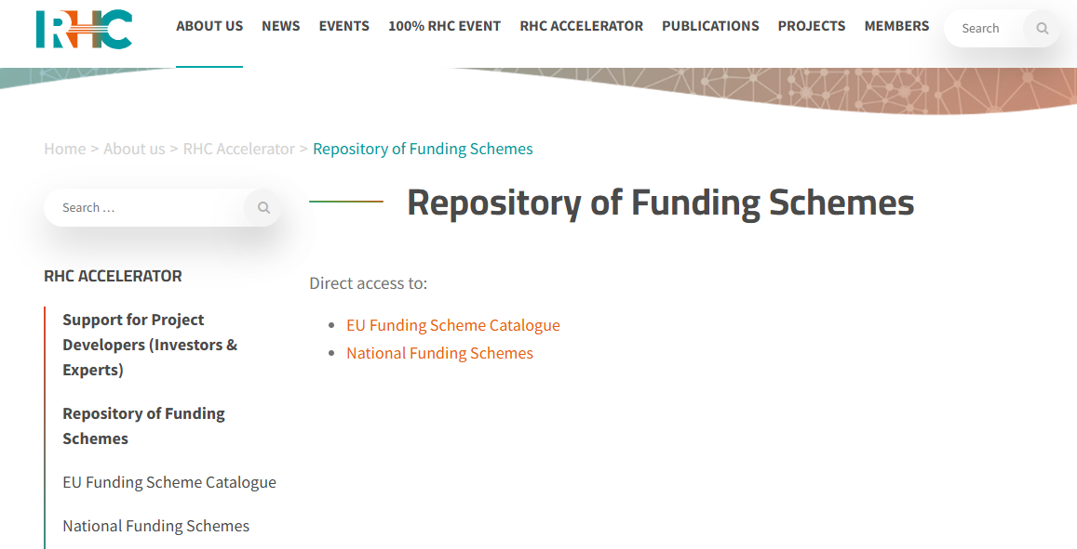
RHC Accelator
Repository of Funding Schemes: https://www.rhc-platform.org/about-us/rhc-accelerator/funding-scheme-catalogue/

Slide 8
RHC Accelator
Repository of Funding Schemes: https://www.rhc-platform.org/about-us/rhc-accelerator/funding-scheme-catalogue/

Slide 9
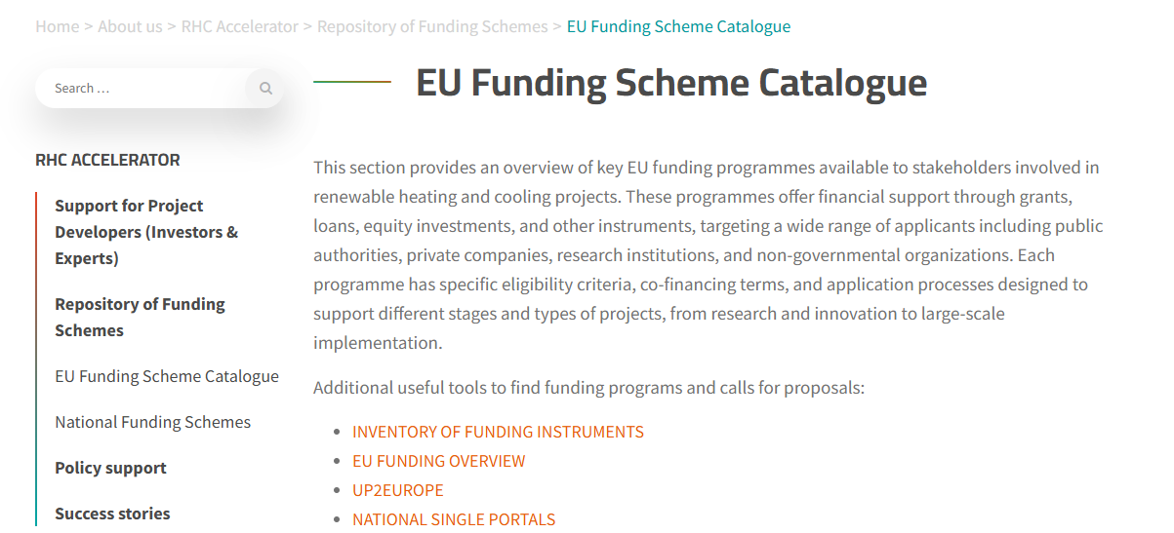
RHC Accelator
Repository of Funding Schemes: https://www.rhc-platform.org/about-us/rhc-accelerator/funding-scheme-catalogue/

Slide 10

RHC Accelator
National Funding Schemes:

Slide 11
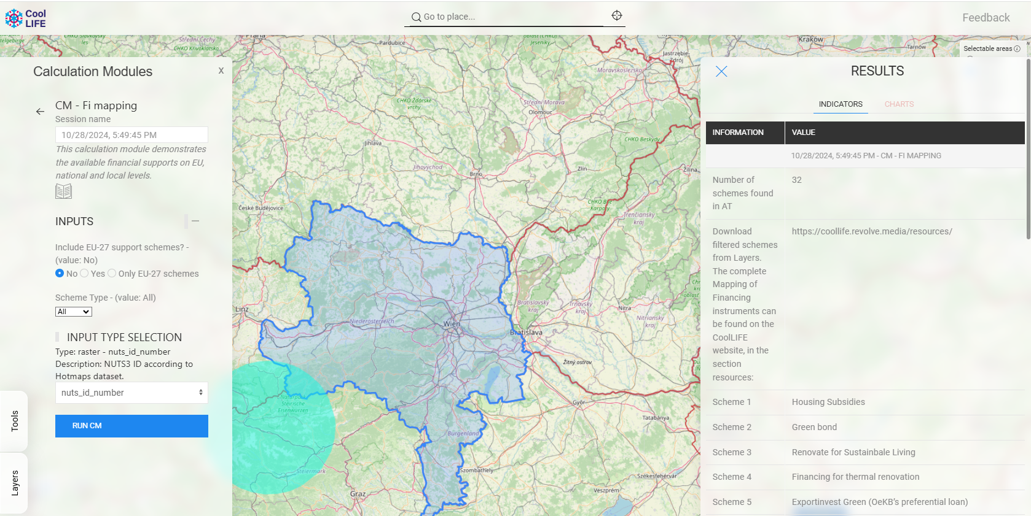
CoolLIFE
CoolLIFE Tool: https://tool.coollifeproject.eu/map

Slide 12
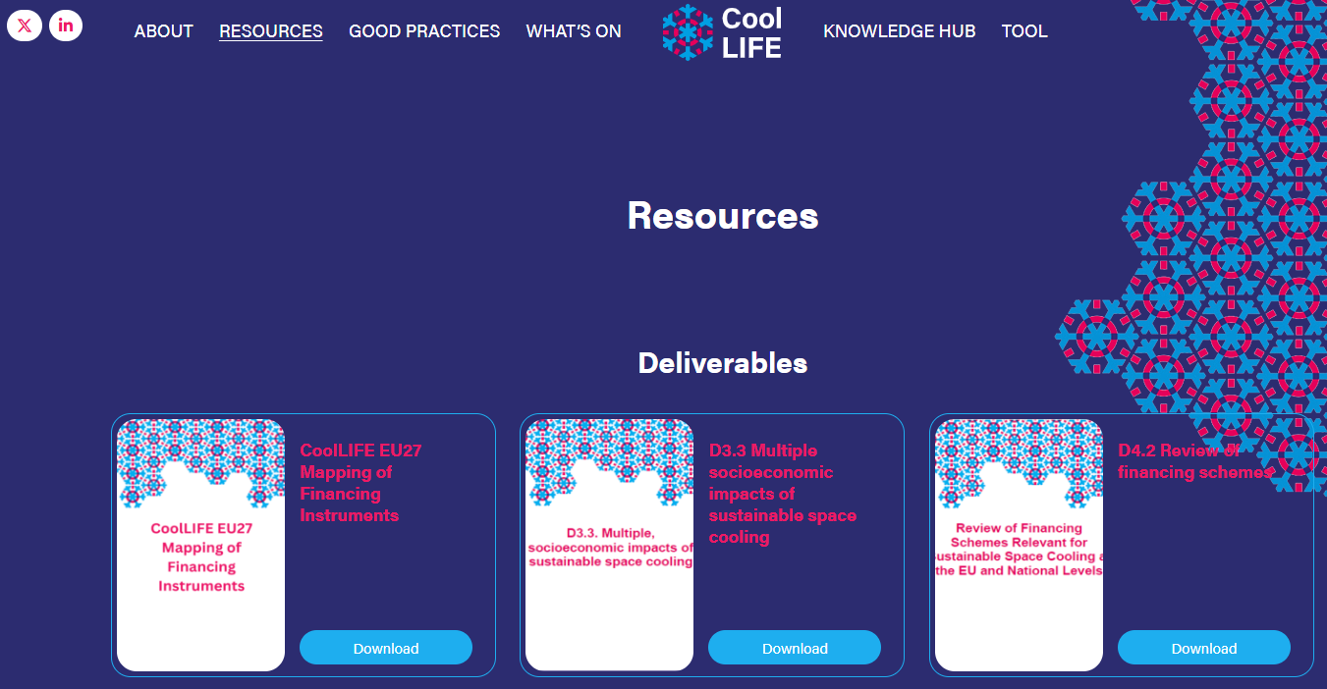
CoolLIFE
CoolLIFE Knowledge Hub & Resources: https://tool.coollifeproject.eu/map

Slide 13

SAPHEA
SAPHEA Market Uptake Hub: https://www.saphea.eu/

Slide 14

Download the full Mapping of Financing Instruments
Are there any questions?
https://zenodo.org/records/13886860 Full Dataset: Building Decarb., H&C and DHC

Slide 15


Giulia Conforto
conforto@e-think.ac.at
Thank you for your attention!
Credit: 1xpert

Slide 16




Financing DHC: Factors to consider
Business Model
Cost Structure
Revenue Stream
Financing
Roles:
Operation and mgmt
Payment for services
Investment
Ownership
Private/public combinations:
Traditional/public agr.
Mgmt agreement
Leasing/Concession agr.
Privatized
ESCO, Energy Communit
CAPEX:
Installation: heat plant, back-up, network pipes, connection, storage…
Other: planning, permitting
OPEX:
Operation: fuel, personnel
Maintenance, heat loss
RISK:
Resources, consumption, retention, debtor, prices
Tariffs: variable rate, fixed rate, risk mitigation, discount rate (return on capital you want to achieve)
One-time Payments: new customer connection
Subsidies: tax rebates, capital grants, operating subsidies
Equity (private equity from project developers, venture capital, external investors, crowdfunding, cooperative, connection fees)
Debt (loans, guarantees)
Grants (capital or operating subsidies, tax rebates)
Alternative Sources (e.g., revolving funds)
Source: Module 5: Heating and cooling market and finance, THERMOS, 2020; Guidelines on Community
Heating and Cooling, RESCOOP, 2023 Icons: Uniconlabs, Vitaly Gorbachev, Freepik, Rukanikon

Slide 17
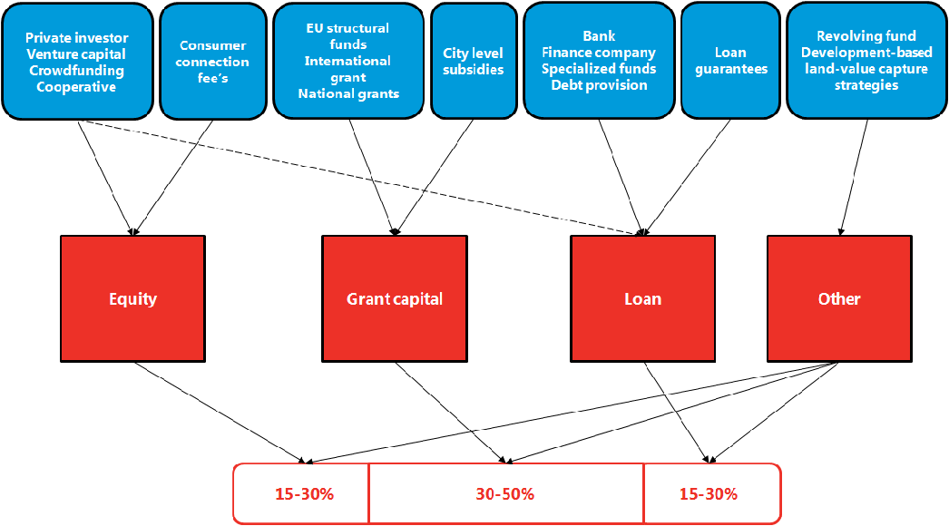
Financing DHC Projects
Source: Module 5: Heating and cooling market and finance, THERMOS, 2020

Slide 18
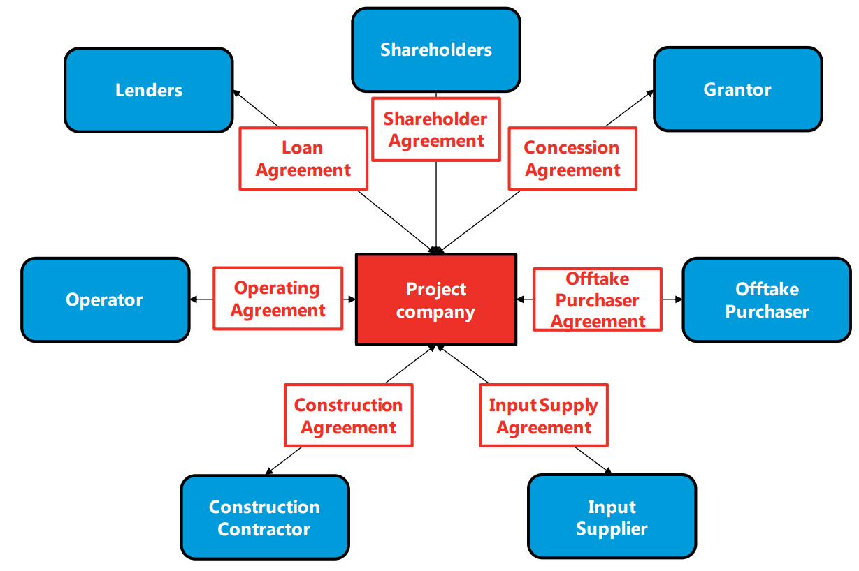
Project Financing for DHC
Project Finance: The funding of long-term infrastructure, industrial projects, and public services using a nonrecourse or limited-recourse financial structure.(Investopedia)
Typical ways in which two or more parties share risk and rewards for a specific project are:
Joint Venture (JV) agreement,
Special Purpose Vehicle (SPV),
Public-Private Partnership (PPP).
Source: Module 5: Heating and cooling market and finance, THERMOS, 2020

Slide 19
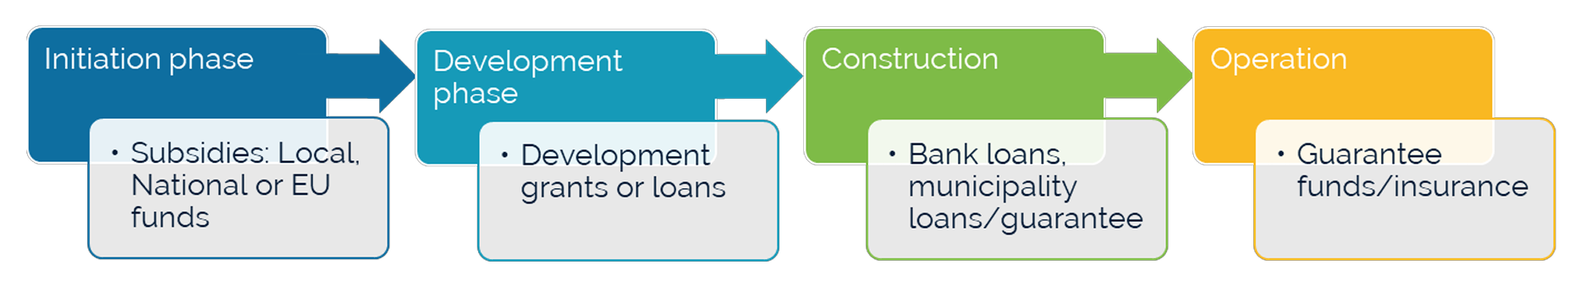
Financial framework for community DHC
Source: Guidelines on Community Heating and Cooling, RESCOOP, 2023

Slide 20
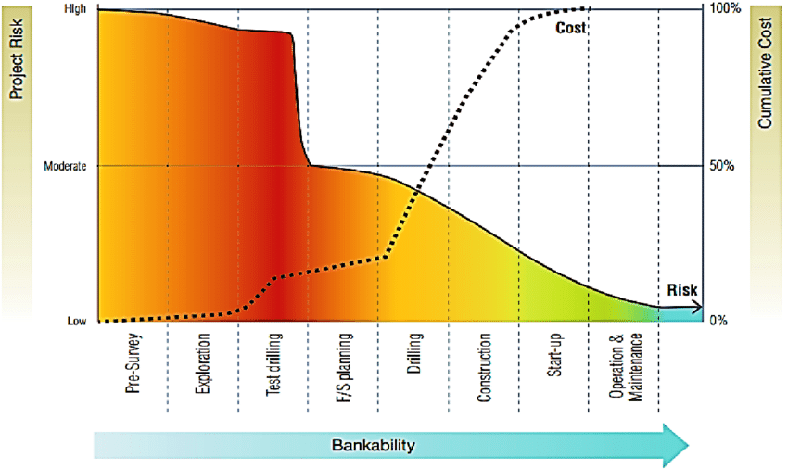
Geothermal Project Risk Curve (e.g., deep geothermal, open loop)
Source: Geothermal Handbook, Gehringer & Loksha, 2012

Slide 21
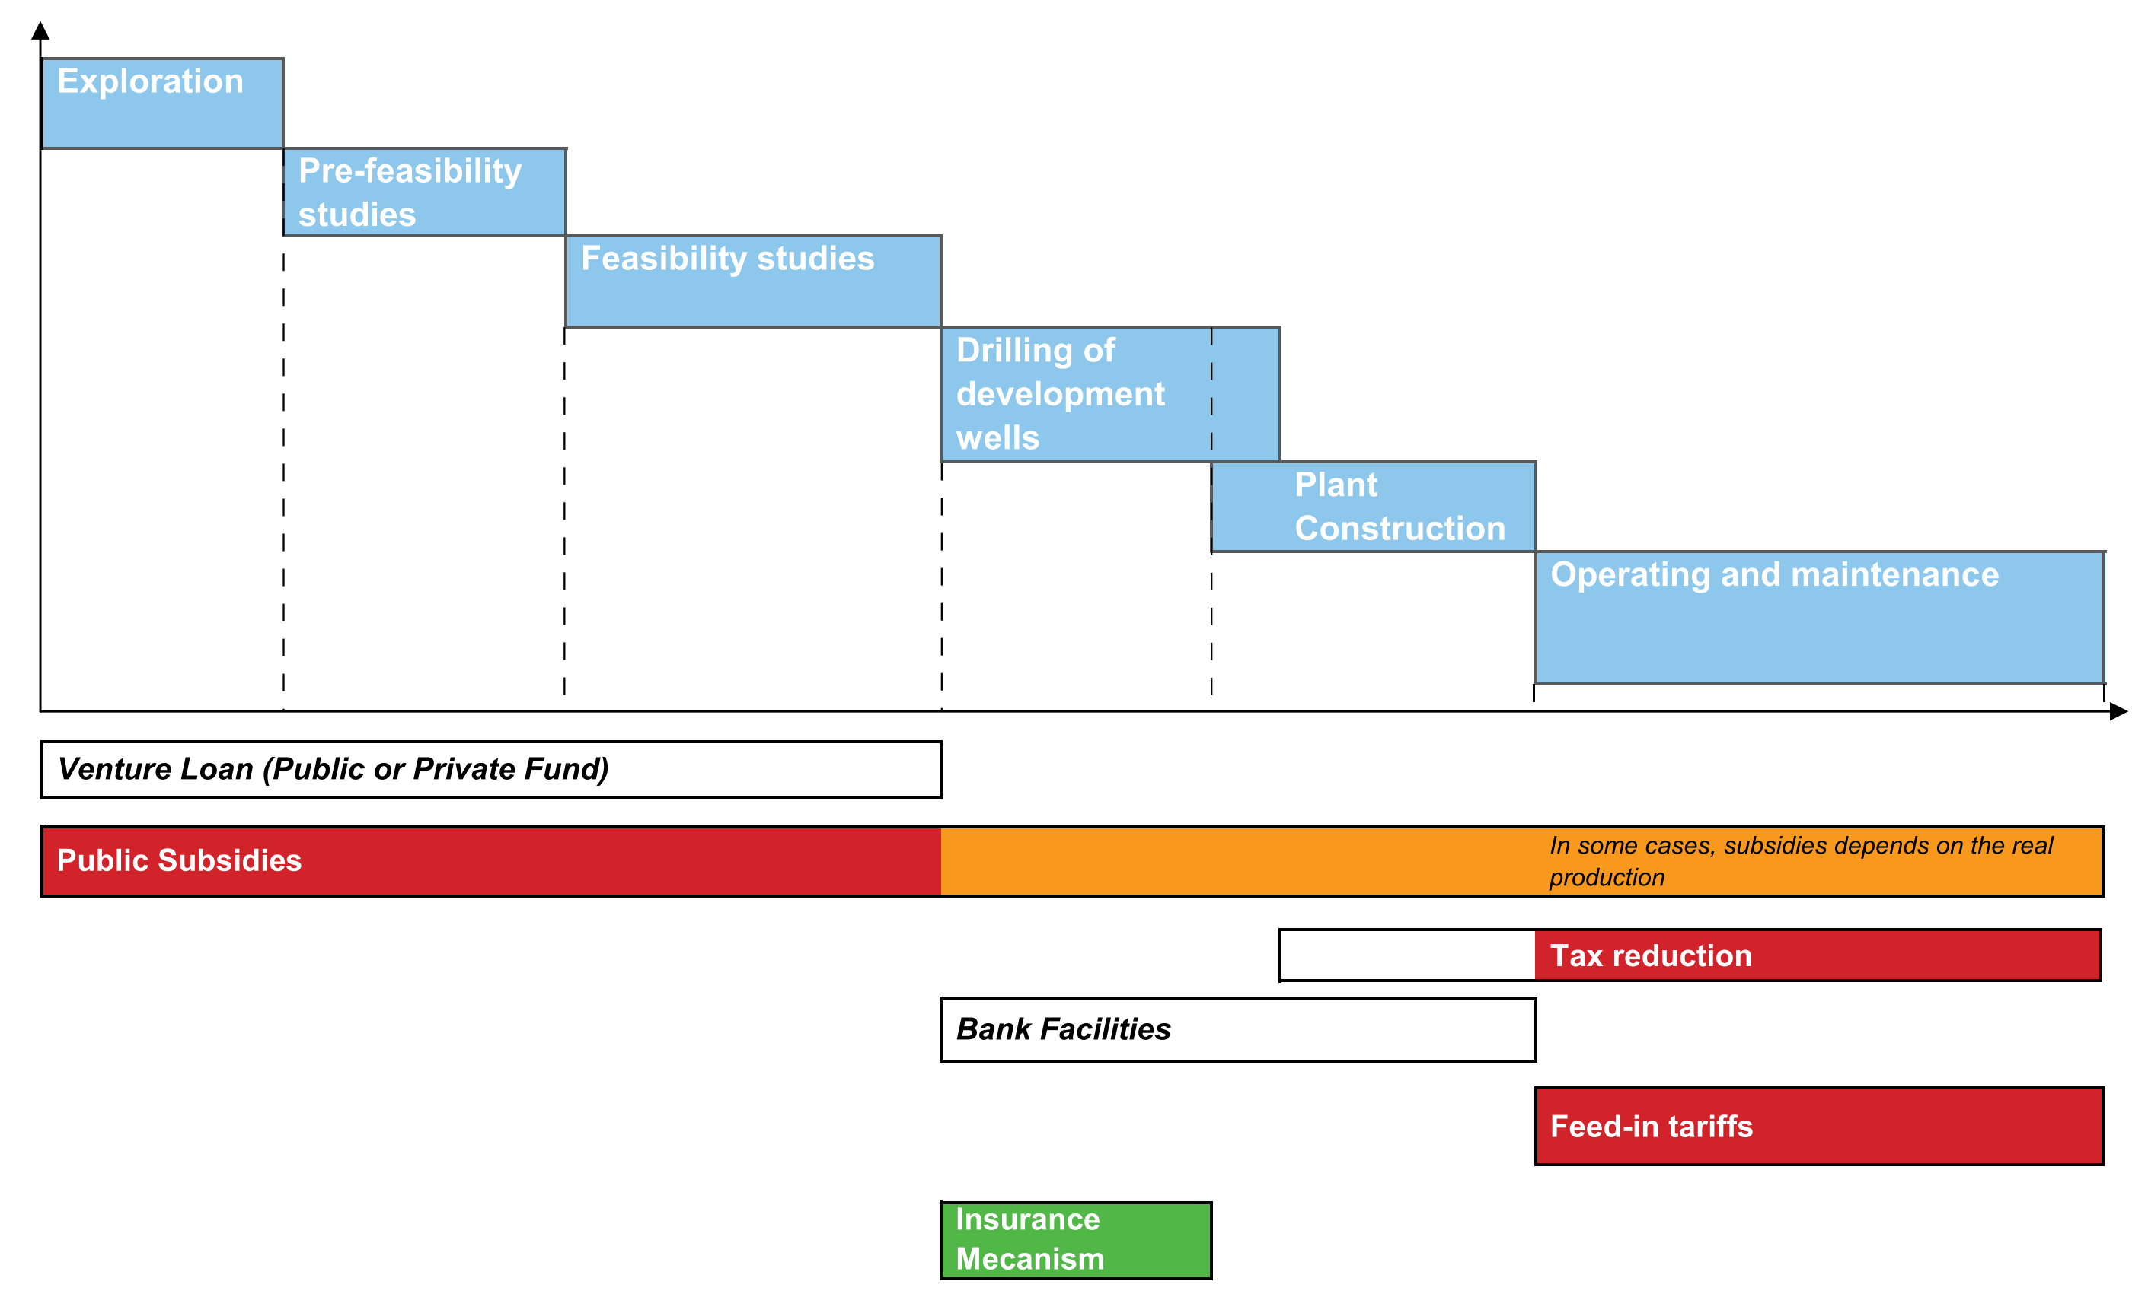
Financing Geothermal Projects
Source: GEOFAR, 2010
Source: SAPHEA, 2024 (NYR)

Slide 22
Public Incentives
Essential to support development of the sector until market uptake
Promote efficiency and RES by lowering CAPEX and OPEX, increasing profitability and bankability
Public Incentives
Investment Grants, Soft Loans, Tax Rebates, and a combination of them
Less common: Guarantees, TA, Advisory Services, Operating Subsidies, Feed-in tariffs, CO2 taxes, etc.

Slide 23
Private Capital
Green loans/mortgages for building renovation and small RES installations
Less common: Equity Investments, Green Bonds, Green Leasing, on bill financing
Private Instruments
Large investments are negotiated on an individual basis and use mostly a combination of venture capital and other sources
Often the applicant creditworthiness counts more than the project risk/ profitability

Slide 24
Heat Purchase Agreement (HPA)
A contract that ensures the project economic viability, by negotiating, before drilling, the sale of heat and cold to the local DH manager, utility or large final customers.
Many projects cannot find any financial support if they cannot provide an HPA.
The HPA or pre-HPA aims to secure the purchase of a minimum amount of heat per year, for a minimum price and a duration (15-30 y).
The presence of some large heat consumer helps the economy of a project greatly.
Source: SAPHEA, 2024 (NYR)

Slide 25
Lessons Learned #1
1
Public Incentives only partially ease access to credit
Benchmarking Platform (e.g. DEEP). Standard Assessment Toolkit. Structural interventions (cost of borrowing).
2
Without legal obligations, incentives are not enough
Obligations to transition/decarbonize, white certificates, carbon tax, building codes for new constructions, etc.
3
Perception bias: higher costs/risks, lower profitability
Communication is key: awareness campaigns, consultations, stakeholder engagement, open-access data, etc.
4
Able to pay does not mean being able to transition
Support all along the process: One-Stop Shops

Slide 26
Lessons Learned #2
5
Budget opacity: only erratically disclosed
Detailed budget data would not disclose details on usage and effectiveness
6
The n. of schemes indicates the strategy, not intensity of support
Is a higher number ispersive of helpful to achieve a greater outreach?
7
Dispersion: hard to find, overlapping, rapidly obsolete
Centralized portals at the national & EU level: CoolLIFE & SAPHEA Tool & Hub
8
Great proliferation of schemes and investment increase
Despite that, CET Investments are still barely half of what needed to achieve 2030 targets

Slide 27
Resources
THERMOS, Module 5: Heating and cooling market and finance, 2020
RESCOOP, Guidelines on Community Heating and Cooling, 2023
Conforto, G. et al., EU-27 Country Mapping of Financing Schemes to Decarbonize Buildings, Heating and Cooling [Data set], 2024, Zenodo, https://zenodo.org/records/13741716
CoolHeating, Guidelines on improved business models and financing schemes of small renewable heating and cooling grids, 2017
HeatNet NWE, HeatNet Guide to Financing 4DHC, 2019
HeatNet NWE, Guide to Governance and Business Models, 2020
GEOFAR, Financial instruments as support for the exploitation of geothermal energy, 2010

